Slide 1
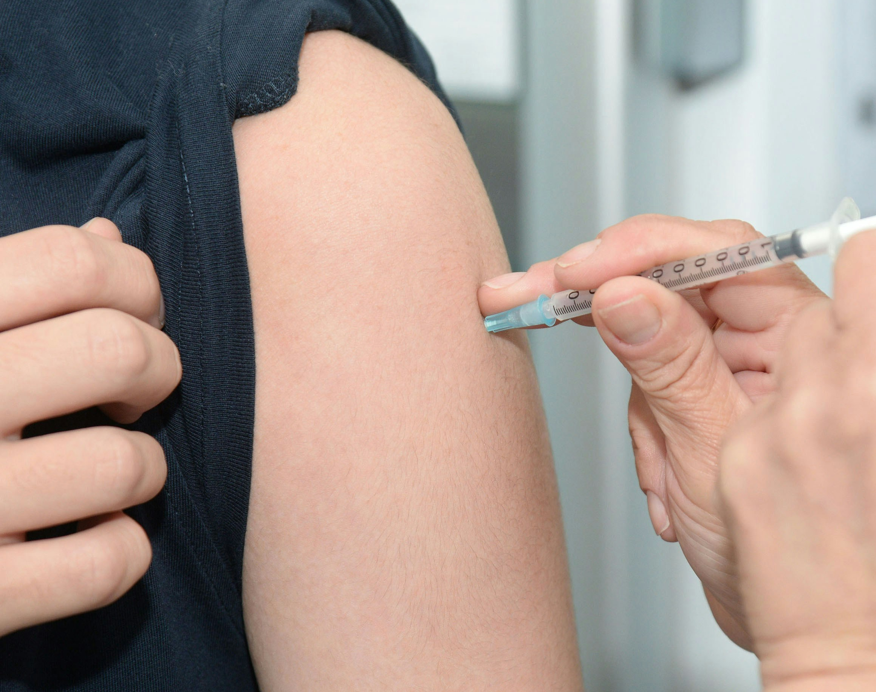
PREDICTING VACCINE UPTAKE FOR TARGETED PUBLIC HEALTH INTERVENTIONS
Jemimah Kuria, Faith Githaiga, George Nyang’aya and Derrick Kiptoo

Slide 2
📌PROJECT OVERVIEW & BACKGROUND
Project Overview: This project predicts the likelihood of individuals receiving seasonal flu and/or H1N1 vaccines using demographic, behavioural, and opinion-based survey data.
Aim: Produce accurate predictions to guide targeted public health interventions and uncover key drivers of vaccine uptake.
Stakeholders: Public Health Agencies, Healthcare Systems, and Government.

Slide 3
💼 BUSINESS UNDERSTANDING
Public Health Challenge: Unvaccinated individuals pose a significant risk of large-scale flu outbreaks, straining healthcare systems and causing substantial socio-economic impact.
Need for Prediction: Accurate prediction of vaccine uptake allows public health agencies to identify at-risk populations and allocate resources more effectively and proactively.
Stakeholder Value: Provides actionable insights for Public Health Agencies, Healthcare Systems, and Government bodies to enhance preventative care and public safety.

Slide 4
❓PROBLEM STATEMENT
Despite wide-scale flu awareness campaigns and vaccine availability, many individuals do not take the vaccine. This makes entire populations vulnerable to flu outbreaks and strains healthcare systems. During pandemics, such as H1N1, knowing which groups are hesitant or likely to opt out of vaccination can make or break a country’s response. This project aims to predict whether a person is likely to receive the H1N1 vaccine and/or the seasonal flu vaccine based on their survey responses, including their demographic details, health status, beliefs, and behavior. By identifying high-risk or hesitant groups, we can help direct resources like public health messaging, vaccine access, and education to the right places at the right time.

Slide 5
🎯 OBJECTIVES
Analysis
Identify the most significant features influencing H1N1 and seasonal flu vaccine uptake.
Modelling
Compare and fine-tune multiple classification algorithms for predicting vaccine uptake.
Deployment
Develop a web-based application for predicting vaccination uptake based on individual characteristics.

Slide 6
🔍 DATA UNDERSTANDING
Source: DrivenData Flu Shot Learning Challenge.
Size & Format: Approximately 26,000 entries in CSV format.
Key Features: Demographics, Health & Access data, Beliefs and Behaviour.
Target Variables: h1n1 vaccine and seasonal vaccine (binary: 1 for vaccinated, 0 for not).
Feature Engineering
Used label encoding for categorical variables.
Created new features for interaction terms and grouping levels.

Slide 7
📊 Exploratory Data Analysis
Most who received H1N1 also took the seasonal vaccine.
Class imbalance present → noted for modelling.
Distributions of H1N1 Concern and Knowledge among respondents.
Behavioural patterns related to vaccine uptake (e.g. hand washing).
Influence of doctor recommendations on vaccine uptake. Demographic influences: age group, education, race, sex, income, marital status, and employment status on vaccine uptake.
Opinions on vaccine effectiveness, risk, and side effects.

Slide 8
🧠 MODELLING & EVALUATION
Tested Models: Logistic Regression, Decision Tree, Random Forest and Gradient Boost.
Evaluation Metrics: Used recall and F1-score as main metrics. Also took note of accuracy, precision and AUC.
Selected Model: The tuned Random Forest was selected due to its strong performance in handling high-dimensional data, its ability to reduce overfitting, and its robust predictive accuracy, making it well-suited for this classification task.

Slide 9
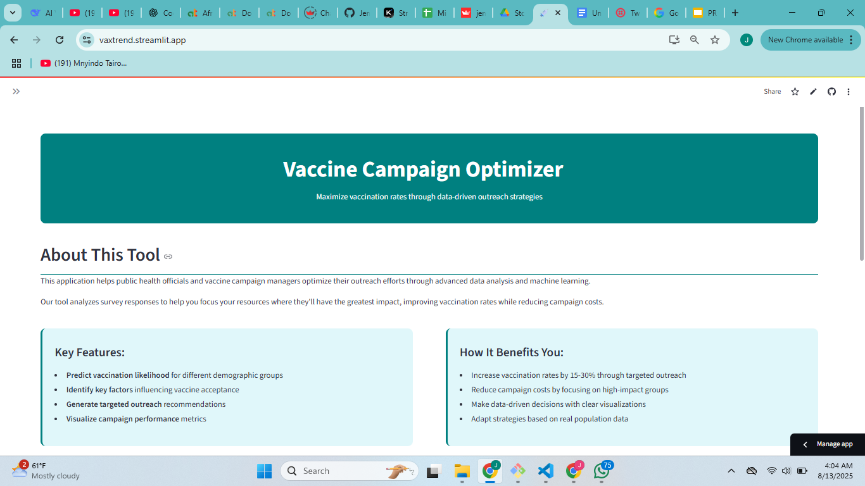
🚀 MODEL DEPLOYMENT

Slide 10
🚀 CONCLUSION
Key drivers of vaccination behaviour were identified, providing valuable insights for public health strategies.
A Tuned Random Forest model demonstrated strong performance, proving to be a robust predictor of vaccine uptake.
An easy-to-use User-Interface was deployed, allowing stakeholders to easily make use of data for decision making as well as reach out to at risk individuals.

Slide 11

🚀 RECOMMENDATIONS
Targeted Campaigns: Use insights from significant features to develop targeted public health messages for hesitant groups.
Improved Access: Enhance vaccine accessibility in areas or for demographics identified as having lower uptake.
Educational Initiatives: Counter misinformation and build trust in vaccines through tailored educational programmes.
Policy Implications: Inform policy decisions for future vaccination efforts, especially during pandemics.
Continuous Monitoring: Implement a system for continuous monitoring and retraining of the models with new data.

Slide 12
THANK YOU ANY QUESTIONS ?

